Slide 1

GuardXLens
AI-Powered Watermark-Based Camera Blocking System for Secure Online Exams
Rizzlers | CIEL Kingston vibeAIthon 2025

Slide 2

The Problem: Online Exam Malpractice
The Vulnerability
The Institutional Pain Point
Candidates use secondary devices to capture exam questions, then feed them directly into AI tools for instant answers. Current proctoring only detects cheating after it happens—too late to prevent it.
Universities and corporations lack a preventive mechanism to stop external devices from photographing secure on-screen content. This creates a critical security loophole that undermines exam integrity at scale.
Our Solution
Future Scope
A two-part system that actively prevents capture before it happens: a watermarked exam web app paired with a custom camera app trained to detect the watermark and disable capture in real-time.
Integrate the GuardLens feature at the Android system level within the camera
API and HAL layers, enabling the native
Camera framework to detected protected digital watermarks restrict image capture providing OS-level prevention of online exam malpractice.

Slide 3

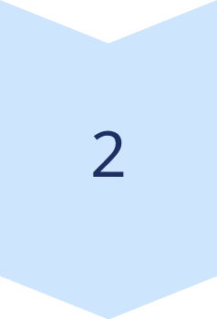

How GuardXLens Works
Step 1: Secure Exam Platform
Admin uploads question papers. Our AI extracts questions and displays them one-by-one with an embedded, universal digital watermark visible across every screen.
Step 2: Watermark Detection
GuardXLens camera app runs a lightweight CNN model on-device to recognize the watermark in real-time from the exam screen. No data is uploaded—processing happens locally for complete privacy.
Step 3: Capture Prevention
The moment the watermark is detected, the camera app's capture button automatically disables. The photo cannot be taken. Malpractice is prevented in real-time.
Technology Stack
Prototype Status
Web: React, Node.js, AI question extraction
Fully functional. We will demonstrate the live interaction between the running web application and the operational mobile camera app, showing watermark detection and capture prevention in real-time.
Mobile: Android (Kotlin/Java)
AI: CNN with TensorFlow Lite on-device deployment

Slide 4

User Experience & Key Innovation
Proactive, Not Reactive
Privacy-First Design
Traditional proctoring detects cheating after it happens. GuardXLens prevents it in the moment—stopping malpractice before external devices can capture anything.
All watermark detection runs 100% on-device using TensorFlow Lite. Zero camera data is uploaded to any server. Users maintain complete privacy while content stays secure.
Proof-of-Concept for OS-Level Protection
This demonstrates a breakthrough approach: an OS-level feature concept (similar to FLAG_SECURE for screenshots) but extended to block external camera capture of secure content.
The Result: Exam administrators gain a powerful tool to protect assessment integrity. Institutions can confidently deploy online exams knowing content capture is technically impossible.

Slide 5



Roadmap & Vision
Model Refinement
Enhance AI robustness across variable lighting conditions, viewing angles, and screen resolutions to ensure reliable watermark detection in real-world exam environments.
Industry Partnerships
Present this functional prototype to major tech platforms and education technology leaders, demonstrating the feasibility of native camera-level security features.
OS-Level Integration
Advocate for integration directly into native Android OS as a native security feature—similar to how FLAG_SECURE prevents screenshots, but preventing external camera capture of protected content.
Commercialization
License technology to educational institutions, corporate testing platforms like Mettl, and any organization requiring protection of secure digital content at scale.

Slide 6
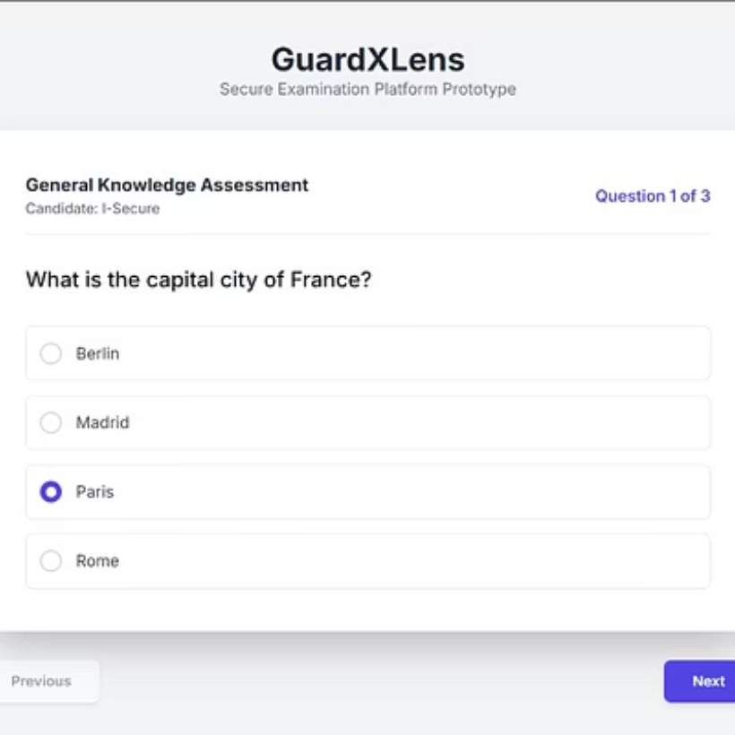
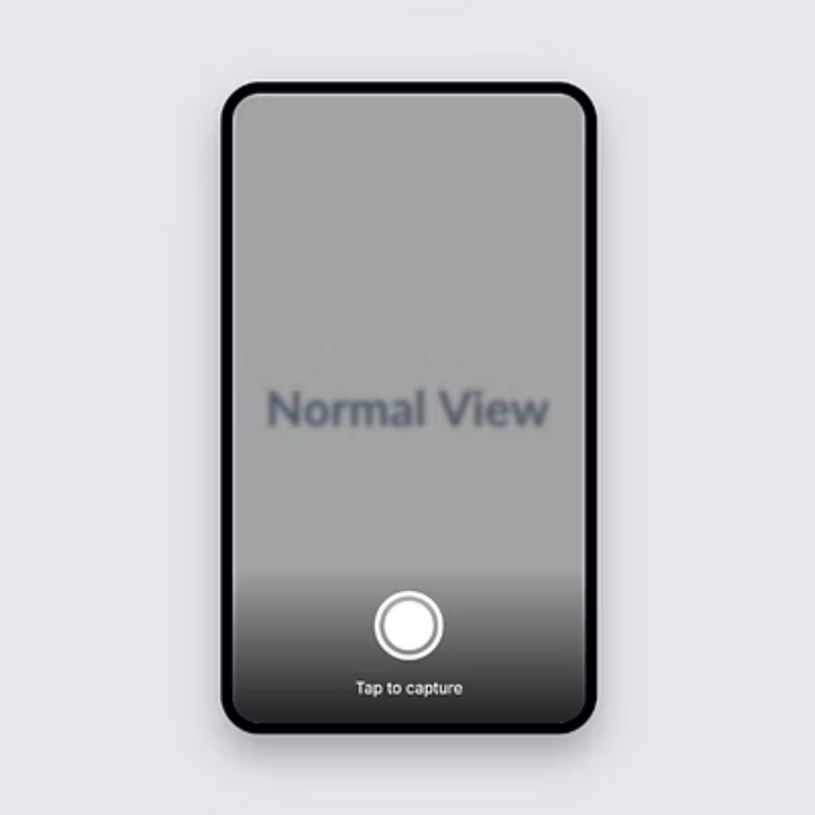
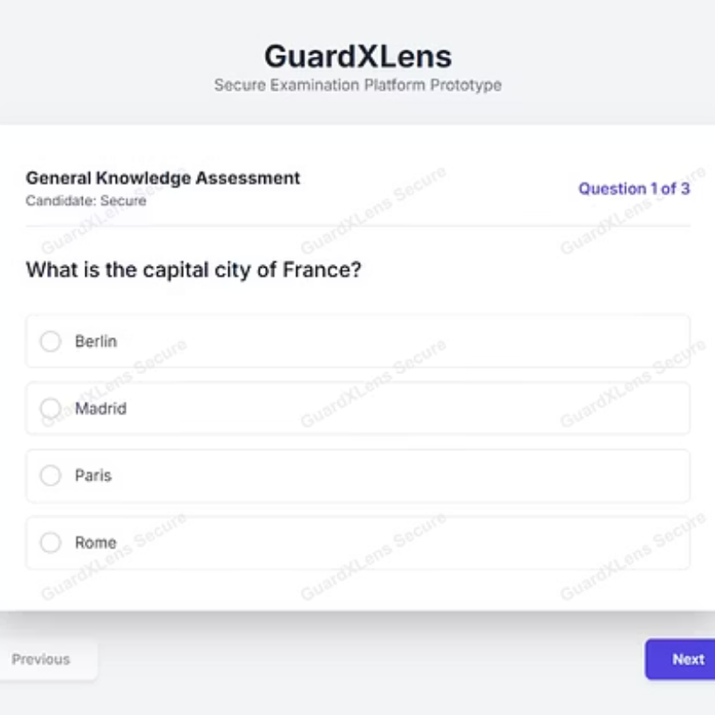
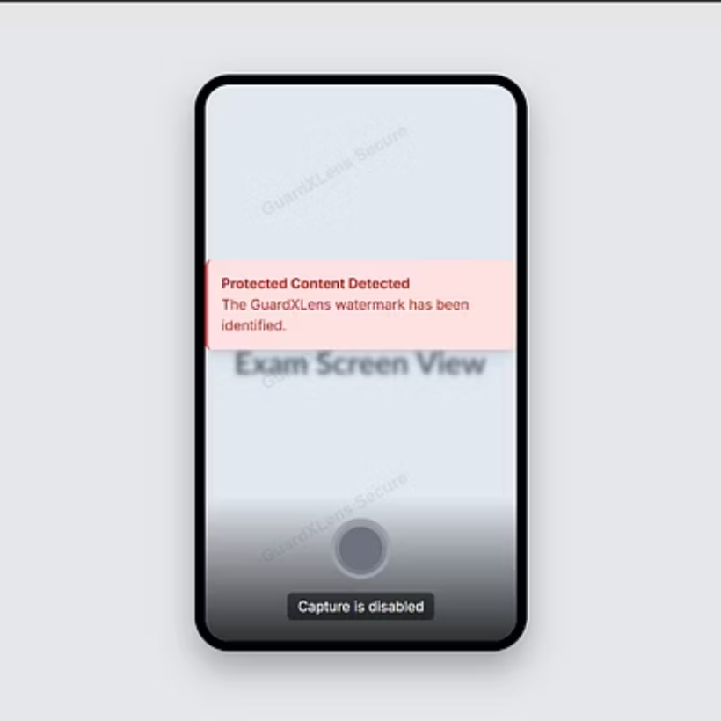
Prototype Demo: Live Screenshots
Below are wireframes and mockups demonstrating the GuardXLens system in action—from exam web interface to camera app detection and capture prevention:
Key Demonstration: The camera app detects the watermark embedded in the exam screen within milliseconds. Upon detection, the capture button transitions to a disabled state, making photography impossible. This live demo shows how GuardXLens prevents cheating in real-time.

